Slide 1
Day Three Home Work Display
Jiaqi Li

Slide 2
Brief Introduction
Normal distribution in 3D
Redo LDA example

Slide 3
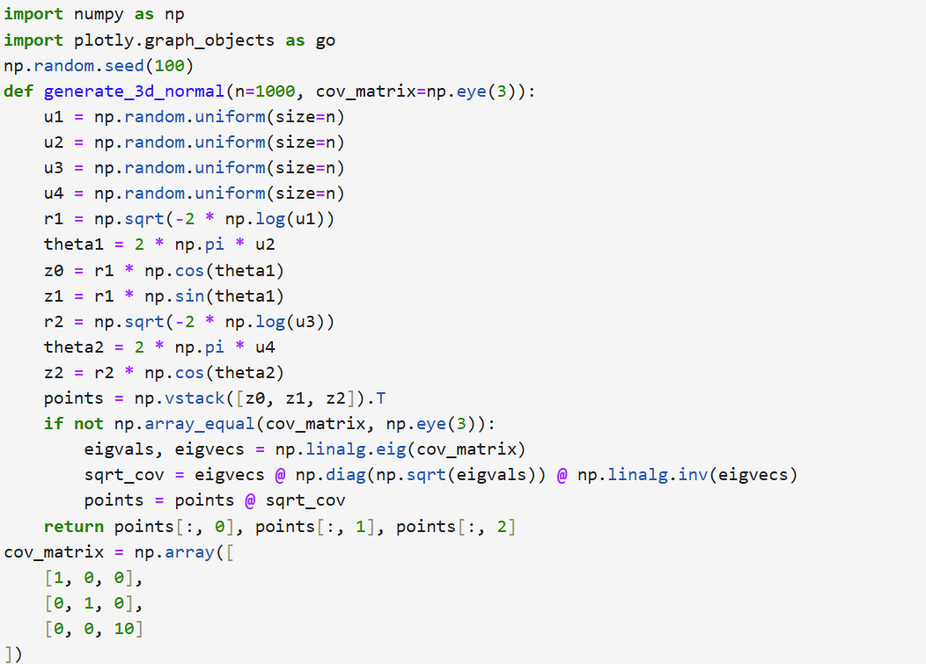
Normal distribution in 3D:code

Slide 4
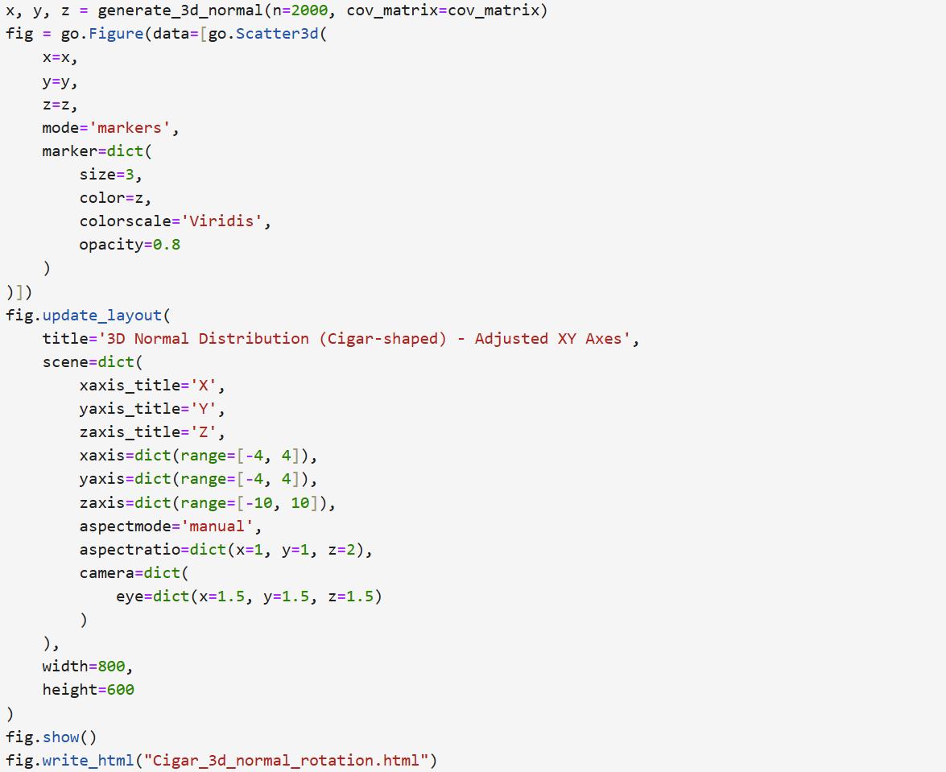
Normal distribution in 3D:code

Slide 5
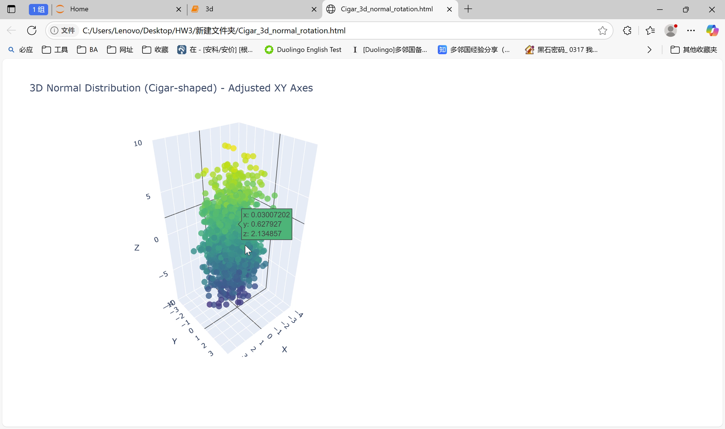
Normal distribution in 3D

Slide 6
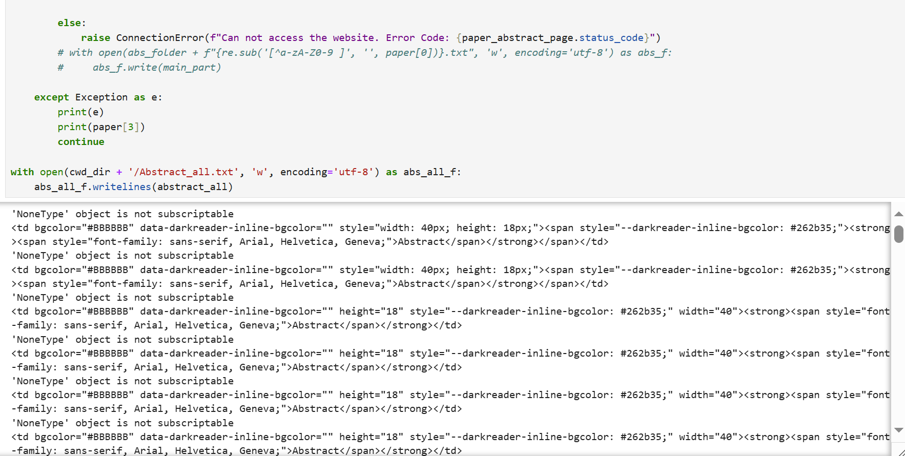
Redo LDA example:running code

Slide 7
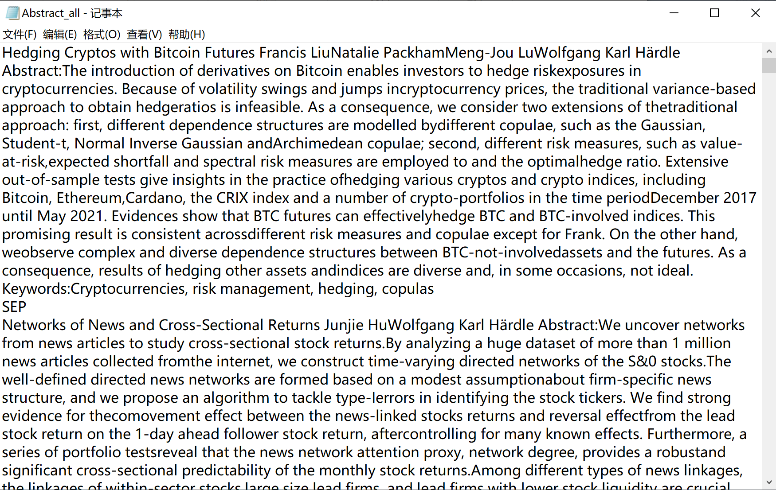
Redo LDA example:result

Slide 8

Redo LDA example:wordcloud

Slide 9
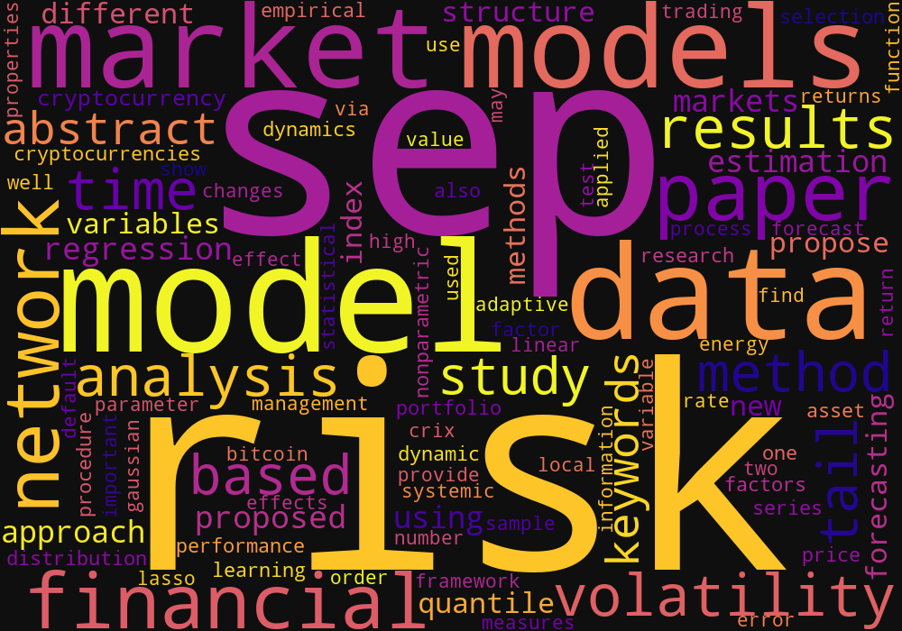
Redo LDA example:wordcloud

Slide 10
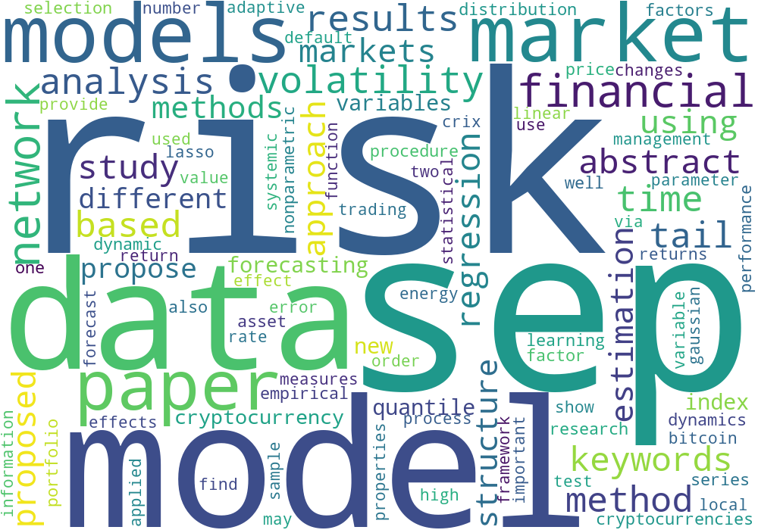
Redo LDA example:wordcloud

Slide 11
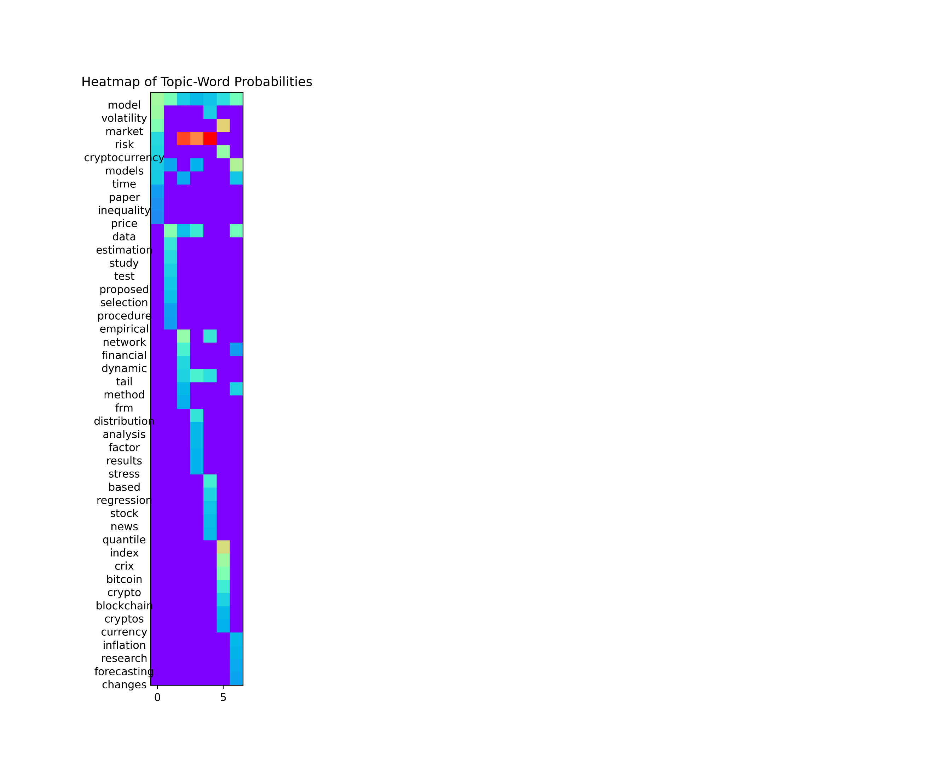
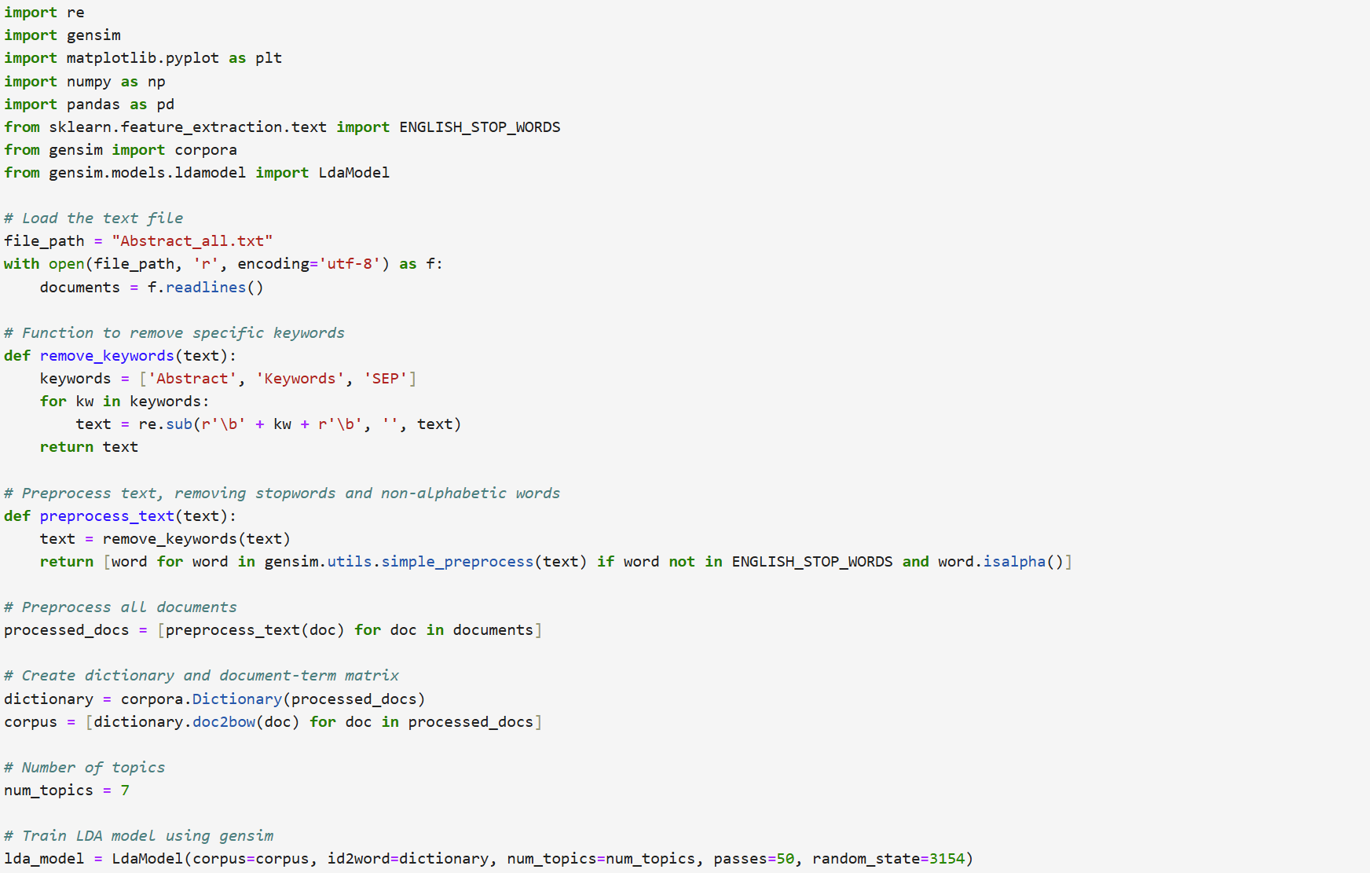
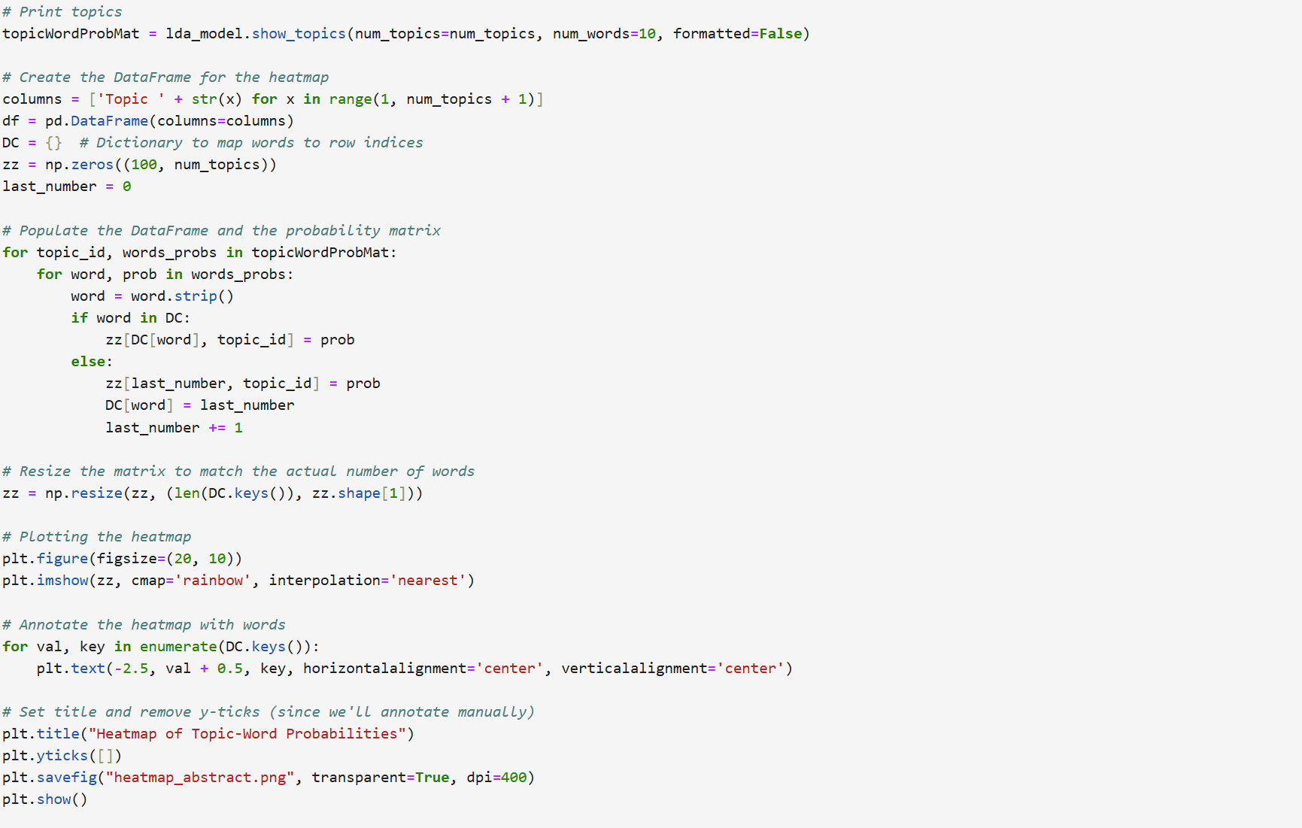
Redo LDA example:heatmap

